Slide 1

PYTHON PROJECT
TOPIC: Predictive Modelling of stock Prices using Linear Regression
Group 5:
441: Vansh Gupta
459: Chirag Sharma

Slide 2


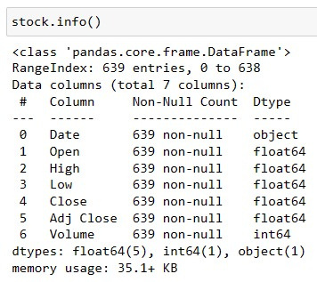
DATA ANALYSIS AND INTERPRETATION
The dataset consists of 639 rows and 7 columns.
1.
2.
The data types include:
object: Date
float64: Open, High, Low, Close, Adj Close
int64: Volume
There are no null or NA values in the dataset.
3.

Slide 3
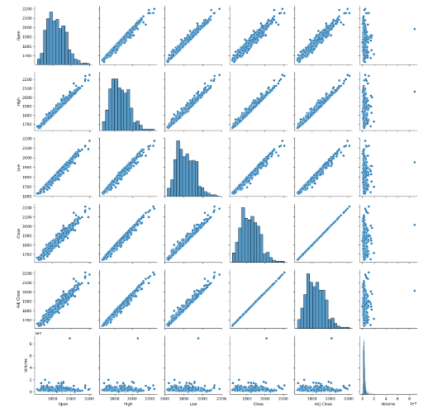


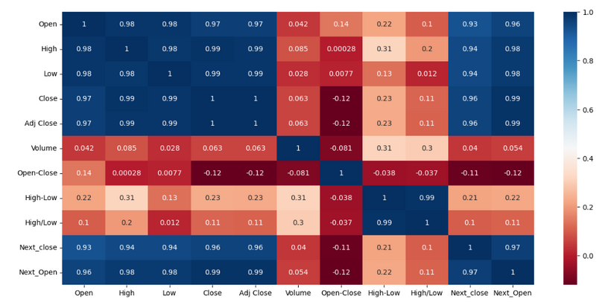
EXPLANATORY DATA ANALYSIS
Most variables show normal distributions, but Volume is peaked at a specific time.
Correlation Analysis:
The Open, High, Low, Close, and Adjusted Close Prices show substantial positive correlations, suggesting strong similarity in their trends.
Conversely, Volume exhibits weaker correlations with the other variables.
Volume seems to display no or negative correlation with the other variables, hinting that its changes might not directly align with price fluctuations.
The Date variable is not considered significant in linear regression modeling due to its lack of numerical relevance, making it unsuitable as an explanatory variable.
The response variable chosen for the linear regression model is the closing price, with the explanatory variables being the open, high, low, adjusted close prices, and volume.

Slide 4
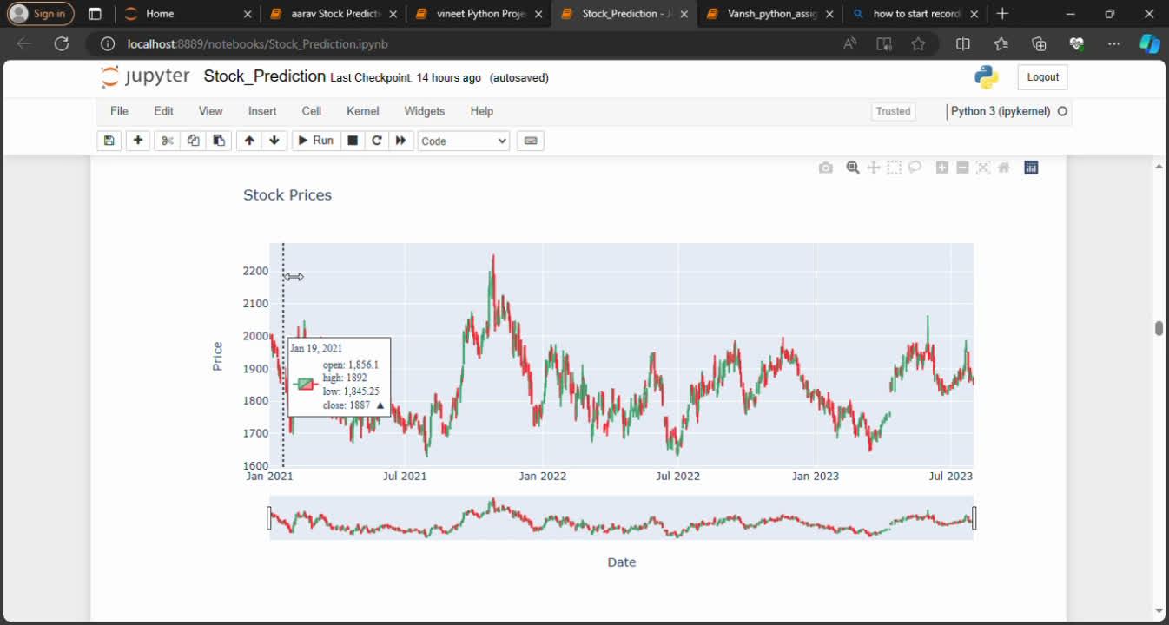

Candlestick Graph for given data

Slide 5

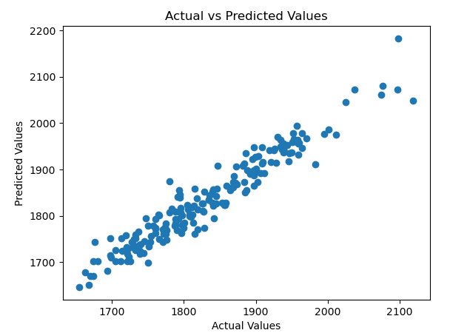
BUILDING AND FITTING THE MODEL
We added additional columns such as Open-close, High-Low, High/Low, Next_Open, and Next_Close to analyze the trend effectively.
Linear regression analysis is used to forecast the closing price by utilizing explanatory variables. The dataset is divided into a 70% training set and a 30% test set to both train the model and assess its accuracy.
To identify the most relevant explanatory variables from a pool of 10 variables, we utilized the Sequential Feature Selector (SFS) with the R2 (R squared) scoring setting.
We have two highly explanatory variables, namely High and Next_Open, with an R-squared value of 0.92643, equivalent to 92.64%.
The analysis concludes that the predicted closing prices closely align with the actual values, indicating an accurate model performance, suggesting that the selected explanatory variables, collectively contribute to the model's ability to predict the closing price.

Slide 6
25.93842
25.9842
MODEL EVALUATION METRICS
A lower MAE, MSE, or RMSE suggests improved accuracy, indicating that the model's performance appears satisfactory with relatively low error metrics.
MAE (Mean Absolute Error)
19.5385
The R² value in regression measures how much of the target variable's variance is explained by the features. An R² close to 1 indicates a good fit, with a value of around 0.9264 showing the model explains 92.64% of the target variable's variance, indicating strong predictive ability.
MSE (Mean Squared Error)
672.8018
RMSE (Root Mean
Squared Error)
25.9384
The residuals are normally distributed, showing that the model meets its assumptions and effectively captures data patterns, explaining target variable variability.

Slide 7
ASSUMPTION TESTING
1.
AUTOCORRELATION TEST:
4.
HOMOSCEDASCITY TEST
(Errors have constant variance):
The Durbin-Watson test statistic, around 1.9522, suggests little autocorrelation in residuals, approaching the optimal value of 2, which is essential for independence in linear regression.
The Breusch-Pagan test statistic is 0.00043, indicating smaller-than-expected residual variance. The p-value of 7.1397e-08 suggests evidence to reject the null hypothesis of homoscedasticity. Thus, the residuals appear heteroscedastic, which can impact the reliability and validity of the regression analysis.
2.
MULTICOLLINEARITY TEST:
NORMALITY OF ERROR TEST:
3.
"Next_Open" and "High/Low" have low VIF values, suggesting minimal multicollinearity. In contrast, "Adj Close" has a higher VIF value (6.340360e+06), indicating substantial multicollinearity. Removing highly correlated variables could affect the model's effectiveness, so retaining them may be beneficial.
Shapiro Wilks test statistic is 0.9867 which is close to 1, thereby residuals appear relatively normally distributed. The p-value of 0.0689 is greater than 0.05, indicating no significant deviation from normality.

Slide 8
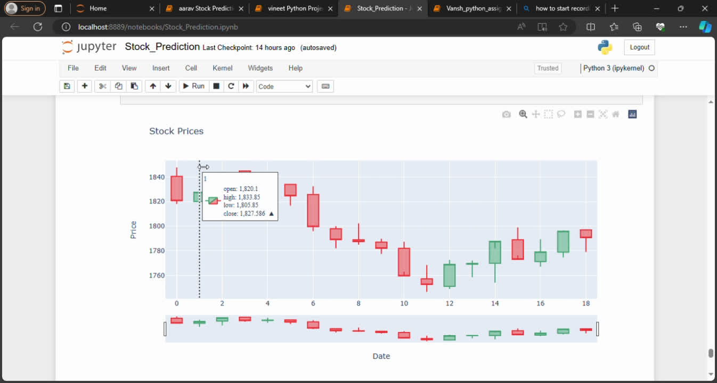
TESTING THE MODEL WITH VALIDATION DATASET
The validation dataset was imported, and a new column named 'Close' was created with 'NaN' values. Subsequently, 'Close' was utilized as the target variable, while other variables served as predictors to predict the closing prices.
Summing up, the model demonstrates strong predictive skills in forecasting closing prices through selected explanatory factors. The assessment encompassed a range of tests, such as assumption validation and multicollinearity verifications, along with metrics like MAE, MSE, RMSE, and R-squared. In general, the model exhibits effective performance with minimal errors and notable explanatory power, as evidenced by a high R-squared value.

Slide 9

R-SQUARED EVALUATION FOR RIDGE, LASSO AND ELASTIC NET
Linear Regression
Rasso Regression
The R-squared value of "0.926534" suggests that around 92.6534% of the variability in the dependent variable is accounted for by the independent variables in the linear regression model.
The R-squared value of "0.9267909
" suggests that around 92.67909% of the variability in the dependent variable is accounted for by the independent variables in the linear regression model.
Ridge Regression
Linear Regression
The R-squared value of 0.926568 suggests that around 92.6568% of the variability in the dependent variable is accounted for by the independent variables in the linear regression model.
The R-squared value of 0.926728 suggests that around 92.6728% of the variability in the dependent variable is accounted for by the independent variables in the linear regression model.

Slide 10
Thank You

